Slide 1

Automobile Data Analysis
Brian, Brett, Carter, Malik

Slide 2

RQ and Hypothesis
Is there a correlation between the city-mpg of a car and the price of the vehicle?
We believe that the city-mpg may in fact play a role in affecting price of a vehicle.
(Hypothesis is supported this presentation will show you how.)

Slide 3
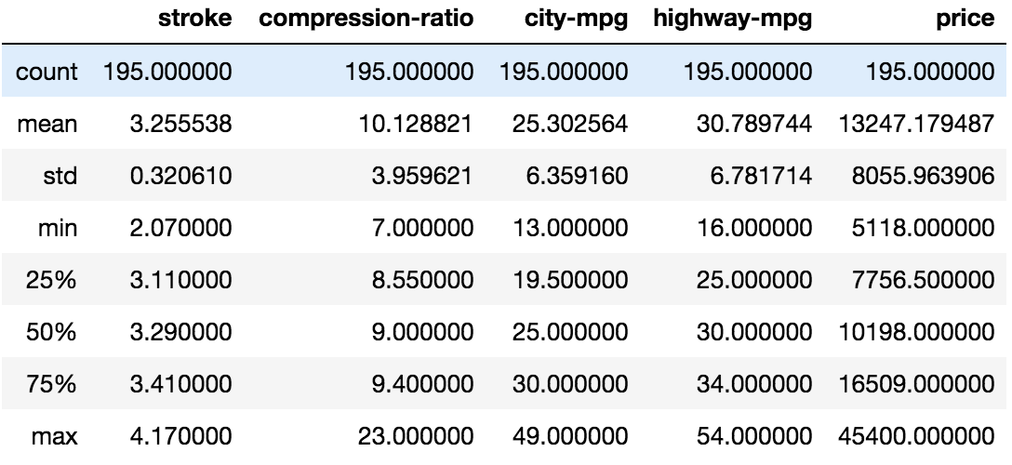

Descriptive Statistics
Visual Chart of the Variables within the Dataset
This Statistical Summary will display the
Mean, Median, Std Dev, and the Quartile ranges for the variables within the dataset, which we are using.

Slide 4
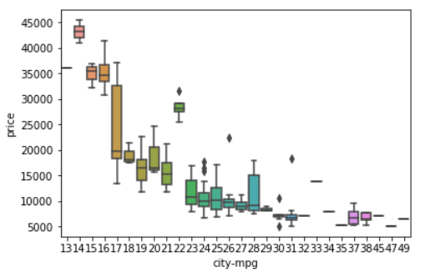
Box Plot
This graph displayed the Q1-Q3 ranges, min and max calculations for the various cars within the dataset.
These cars were placed hand in hand and compared to their total pricing allocations.
This plot shows there is a varying distribution between all the city-mpg between vehicles. Some distributional splits are larger than others.

Slide 5
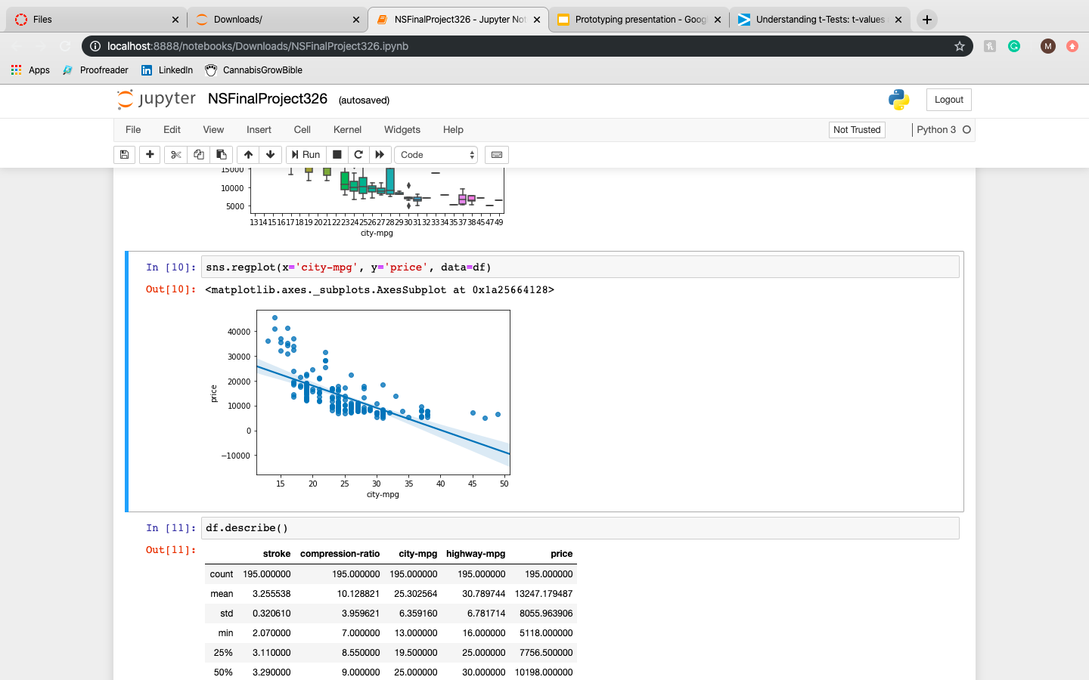
Linear Regression
Regplot used to visualize a linear relationship as determined through regression.
This scatterplot is displaying the negative correlation between the city-mpg and the price of cars.
Looking at the line and the pattern of the dots, it is apparent there is a strong yet negative correlation between the two variables.

Slide 6
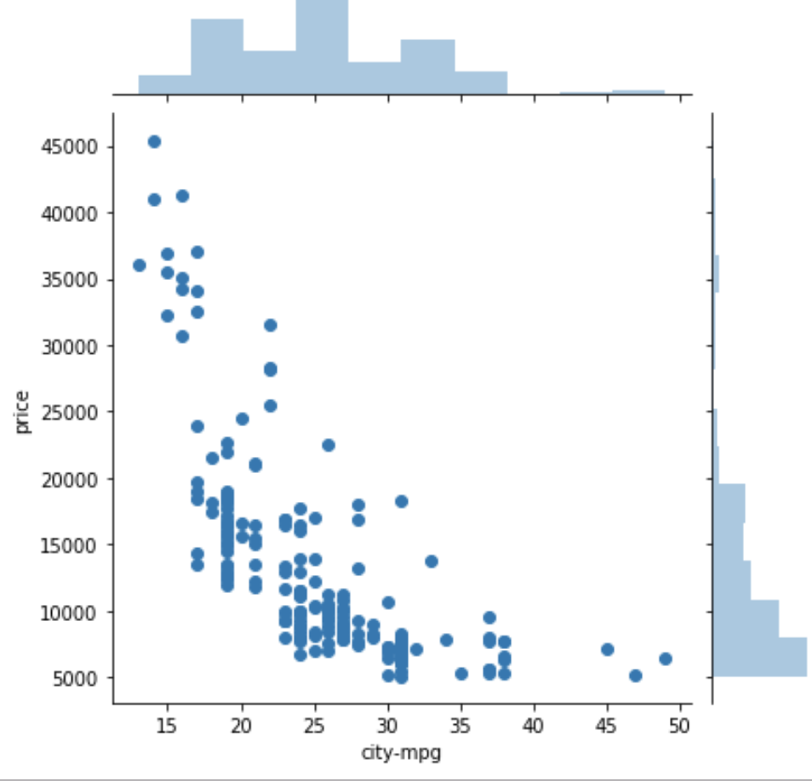
Joint Plot
In the scatter of the plot, it is apparent there is a strong to moderate relationship between the city-mpg and the price variables.
The marginal distributions give a display of the spread of the city mpg in comparison to the price. It is apparent some of the prices would appear higher than one another. There is a skew present to the distribution on the right side.

Slide 7
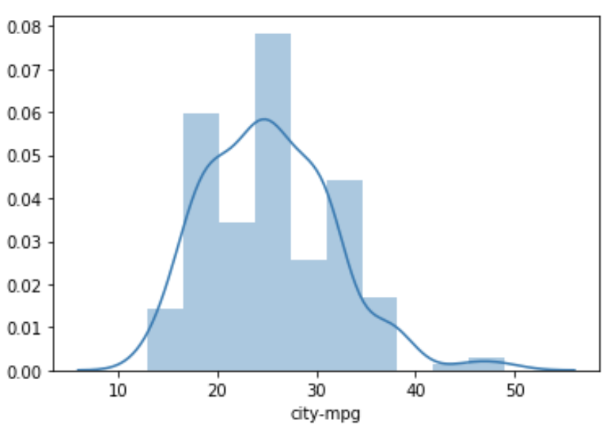
Distribution Plot
The distributional plot is a visual display which detailed the overall distribution of the variable city-mpg.
As you can observe from the distribution curve encompassing the marginal distributions the spread is rather normal, with a slight skew on the MPG past 37.

Slide 8
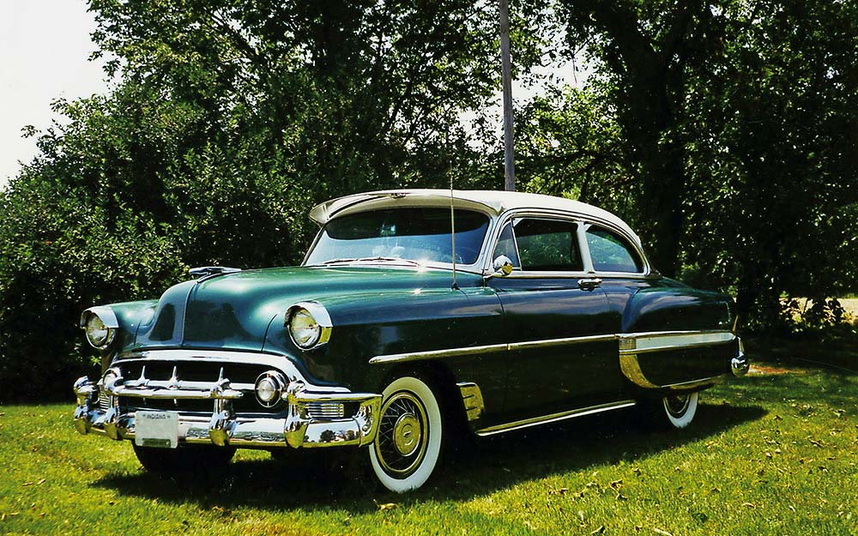
T-Test
Question: Is there a difference in sales price on average between the two-door car and four-door?
Results :
Ttest_indResult(statistic=0.9393530103428416,
pvalue=0.3487236532346948)
Our T-test examined the categorical variable num-of-doors (two or four) and the numerical variable city-mpg (1,2,3,4…)
Since the P-value is less than .05 the results of the t-test tell us the results are not statistically significant.

Slide 9
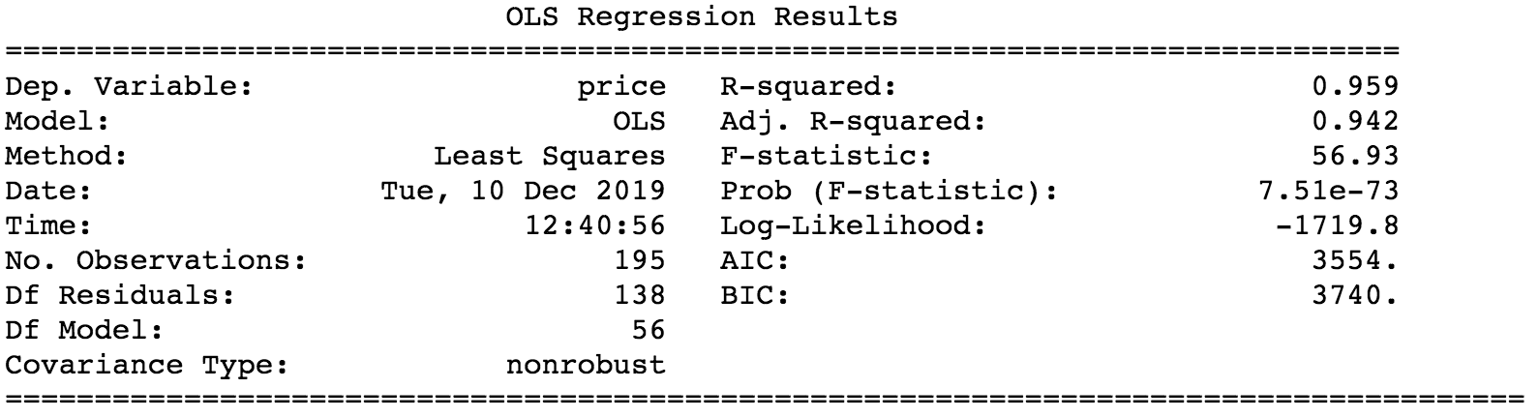
Linear Regression Analysis

Slide 10
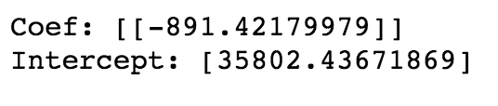
Analysis Explained
The adjusted R value in our Linear Regression Analysis tells us that the linear regression model accounts for 94% of the variance within the distribution.
The F statistics of 57% displays that the likelihood of the results occurring by chance.
Second Regression Analysis:
The Negative Coefficient Value displays a negative linear correlation, there is a $891 dollar decrease for every change in the mpg as seen by the Coefficient. The intercept displays to us the mean-value when X is = 0 within the dataset.

Slide 11
Works Cited/Images
https://www.motor1.com/bugatti/chiron/
https://www.impactbnd.com/blog/ab-testing-inspiration
https://www.wired.com/2017/02/review-2017-lamborghini-aventador-s/
https://www.rd.com/culture/vintage-retro-cars/

